Slide 1

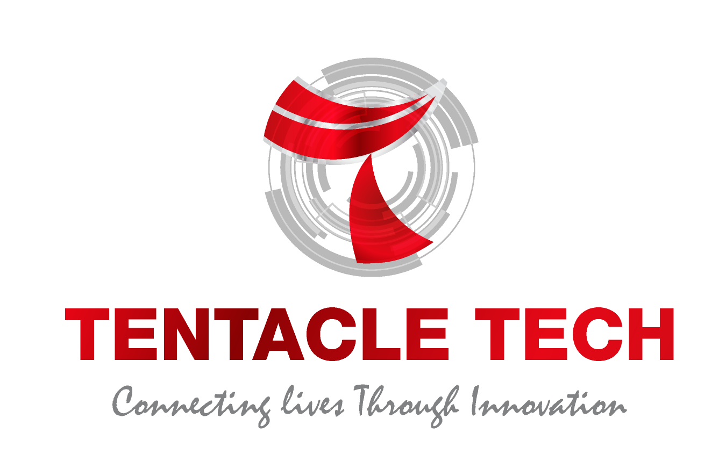
Presentation on Manual Testing Training
MALAYSIA | SINGAPORE | INDONESIA | INDIA |

Slide 2

Agenda
1. Software Testing
3. Benefits of Software Testing
5. What is Manual Testing
7. Advantages of Manual Testing
9. Types of Manual Testing
8. How to do Manual Testing
10. Disadvantages Manual Testing
2. Why Software Testing is needed?
6. Goals of Manual Testing
4. Types of Software Testing
11. Our Success Story
12. Software Testing Challenges In Tech Industry
13. Conclusion
Copyright © Tentacle Group, 2021|Private
2

Slide 3
Software Testing
Software Testing is a process used to identify whether the actual software product matches expected requirements and to ensure that software product is defect & bug free. The purpose of software testing is to identify errors, gaps or missing requirements in contrast to actual requirements before it’s reached the end users.
Manual Testing is the process where testing of a web application is done manually, by human action simulating the end user/clients
Copyright © Tentacle Group, 2021|Private

Slide 4
Different Between SDLC & STLC
Parameter | SDLC | STLC
Origin | Development Life Cycle | Testing Life Cycle
Objective | To complete successful development of the software including testing and other phases. | The only objective of the STLC phase is testing.
Requirement Gathering | In SDLC the business analyst gathers the requirements and create Development Plan | The Testing Team analyze requirement documents like functional and non-functional documents and create System Test Plan
High & Low-Level Design | In SDLC, the development team creates the high and low-level design plans | The software tester creates the Test Plan
Coding | The real code is developed, and actual work takes place as per the design documents. | The testing team prepares the test environment and executes them
Maintenance | SDLC phase also includes post-deployment supports and updates. | Testers, execute regression suits, usually automation scripts to check maintenance code deployed.
Copyright © Tentacle Group, 2021|Private

Slide 5
Why Software Testing is need?
1.In April 2015, Bloomberg terminal in London crashed due to software glitch affected more than 300,000 traders on financial markets. It forced the government to postpone a 3bn pound debt sale.
2.Nissan cars recalled over 1 million cars from the market due to software failure in the airbag sensory detectors. There has been reported two accident due to this software failure.
3.Starbucks was forced to close about 60 percent of stores in the U.S and Canada due to software failure in its POS system. At one point, the store served coffee for free as they were unable to process the transaction.
4.Some of Amazon’s third-party retailers saw their product price is reduced to 1$ due to a software glitch. They were left with heavy losses.
5.Vulnerability in Windows 10. This bug enables users to escape from security sandboxes through a flaw in the win32k system.
6.In 2015 fighter plane F-35 fell victim to a software bug, making it unable to detect targets correctly.
7.China Airlines Airbus A300 crashed due to a software bug on April 26, 1994, killing 264 innocents lives

Slide 6
Benefits of Software Testing
Cost-Effective
Security
Product quality
Customer Satisfaction
1.Cost-Effective: Testing any software on time helps to save money for the company in long term. Suppose if defects/bugs caught in the earlier stage of software testing phase, it costs less to fix rather in production or warranty stage.
2.Security: People are looking for trusted products. It helps in removing risks and problems earlier.
3.Product quality: Testing ensures a quality product is delivered to customers.
4.Customer Satisfaction: The main aim of any product is to give satisfaction to their customers. UI/UX Testing ensures the best user experience.

Slide 7
Types of Software Testing
Software Testing Methodologies
UAT
Performance Testing
Regression Testing
System Testing
Integration Testing
Smoke Testing
Unit Testing
Security Testing

Slide 8
What is Manual Testing
Manual Testing is a type of software testing in which test cases are executed manually by a tester without using any automated tools.
The Purpose of Manual Testing is to identify the bugs, issues, and defects in the software application. Manual software testing is the most primitive technique of all testing types and it helps to find critical bugs in the software application.

Slide 9
Advantages of Manual Testing
Manual testing can be done on any type of application
It is preferable for short sprint cycle products
Newly authored test cases should be executed manually
Application must be tested manually before it is automated
It is preferred in the projects where the requirements change frequently and for the products where the GUI changes constantly or agile based projects
Cheaper cost in terms of initial investment compared to Automation testing
Requires less time and expense to begin productive manual testing
Enables tester to perform adhoc testing
There is no necessity to the tester to have technical knowledge

Slide 10
Goals of Manual Testing
Ensure that the application is error free and it is working in conformance to the specified functional requirements.
Test Suites or cases, are designed during the testing phase and should have 100% test coverage.
Makes sure that reported defects are fixed by developers and re-testing has been performed by testers on the fixed defects.
Testing checks the quality of the system and delivers bug-free product to the customer.

Slide 11
How to do Manual Testing
Understanding the requirements
Test cases authoring
Executing the Test Cases
Defect Management
Reporting
Business Unit/Client will provide the SRC documents. Testers need to read, analyze and under the test scenarios
Testers will required to authored the test cases based on the test scenarios
Execution of the test case will be don in test management tool like ALM, JIRA or etc
In this phase, Testers will logging defects/bugs in to test management tools. Will be communicating with business unit and developers to resolve the issue. Ultimately all issue need to retested and the tickets need to close with proper resolution.
Daily reporting of the testing will be generated and email to Client Manager. Different company might have different parameters of reporting

Slide 12
Type of Manual Testing
Manual Testing
Black Box Testing
White Box Testing
Unit Testing
Integration Testing
System Testing
Acceptation Testing
Copyright © Tentacle Group, 2021|Private

Slide 13
Disadvantages of Manual Testing
Human Resource
Requires human intervention for test execution.
Costing
Requires skilled labor, long time & will imply high costs.
Skillset
Any software can be tested manually, however some might need some special skillset
Work Style
Manual testing can become repetitive and boring.

Slide 14






Our Success Story
Professionally managed by a team of Local Industry Experts having reusable test case repository of
900+ New Business, 1100+ Policy Servicing
450+ Claims, 420+ Underwriting,
200+ Banking, 500 + Loan, 750+ Wealth Mgmt
30 + Functional Test Projects
02+ Performance Test Projects
15+ Years of delivery Experience
150+ qualified test engineers
30%(6 out of 20) Term Insurance, 20%(6 out of 28) medical insurance product in Malaysia is tested by Tentacle*
Expert in Open Source, Code Less & licenced test automation tool
Expertise in AS400 test Automation solution in Malaysia
Complete Automation Solution integrate with Defect Management and GIT Platform
* Data as of Dec 2020

Slide 15
Software Testing Challenges In Tech Industry
Process :
People dependent
Knowledge retention
Tedious documentation process
Non-reusable test data, test data management
Test coverage
Operation :
Planning on Batch execution and verification
Tiresome co-ordination with multiple department ( Finance, Actuarial)
High nos of production incident
Information Technology(IT) :
Manual product creation
Generation of report
Business :
Risk exposure
Higher Testing process cost
Delay product launch time
Copyright © Tentacle Group, 2021|Private

Slide 16
Conclusion
On conclusion manual testing is a process where the software testers are required to be very patient, creative and open minded. Good communication and able to collaborate with developers and business user are also needed as it’s the part of the lifecycle of testing.

Slide 17

Copyright © Tentacle Group, 2021|Private

Slide 18


Reach us
Malaysia
Block 3b-09-05, Plaza Sentral, Jalan Stesen Sentral 5, 50470 Kuala Lumpur, Malaysia, Tel : +60 3 2282 1541
Block A-20-1, Menara Atlas, Plaza Pantai, No:5, Jalan 4/83a, Off Jalan Pantai Baru, 59200 Kuala Lumpur, Malaysia, Tel : +60 3 2282 1541
India
Sahas Embassy, 2
Floor, New No. 131/8, Old No. 145/8, NM Road, Chennai – 600 029
+91 44 2374 0400
sales@tentacletech.com

